Slide 1

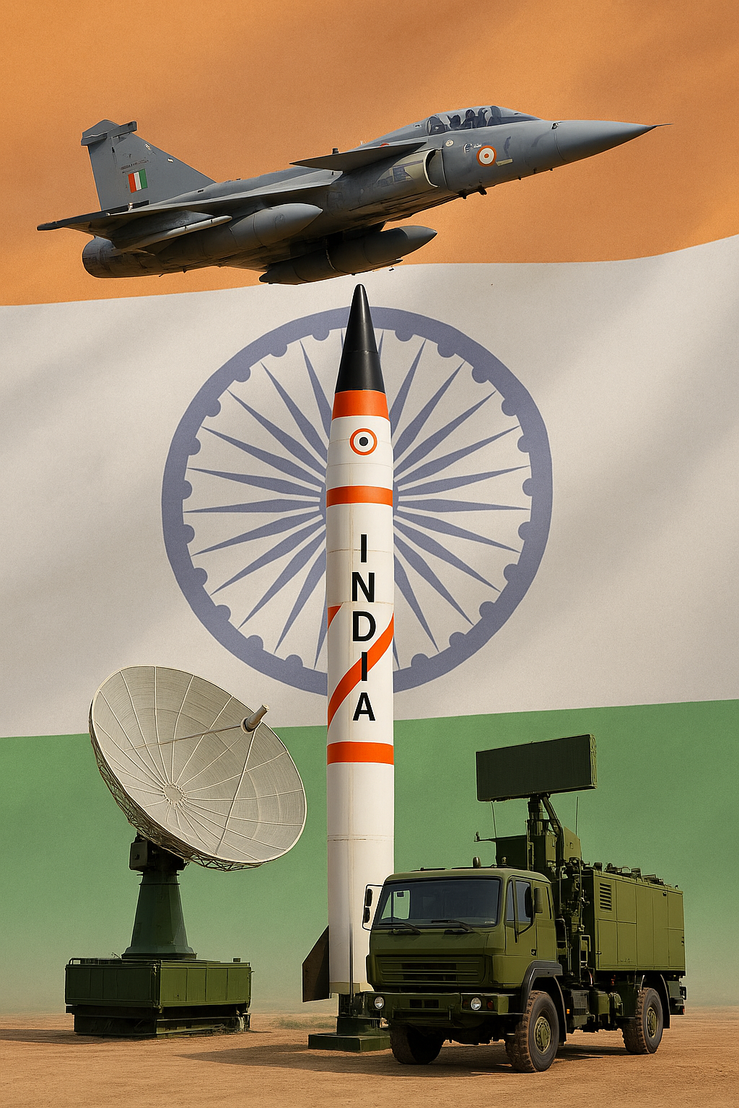

Tiranga Aerospace: Pioneering Indigenous Solutions for Defence and Aerospace
Welcome to Tiranga Aerospace, where innovation meets precision in the heart of India's aerospace and defence ecosystem. We are dedicated to delivering cutting-edge, indigenously developed solutions.

Slide 2


Tiranga Aerospace: Company Overview
Established in 2016 in Bengaluru, Tiranga Aerospace has transformed from a defence distribution company into a comprehensive design and development firm. We are a proud supporter of the Make in India initiative, providing end-to-end capabilities across the aerospace and defence sectors.
1
2
3
End-to-End Capabilities
Technical Expertise
Modern Infrastructure
From design to deployment, we cover every stage of product development.
Specialized in critical defence-grade solutions.
Equipped to manage the entire product lifecycle in-house.
RF Systems & Embedded Solutions
Advanced tools and infrastructure
Design, Simulation, Fabrication
Assembly, Testing
Wiring Harnesses & Test Jigs
Highly skilled engineering team
AMC Services, Turnkey Solutions
Mechanical Design & GUI Software
Reliable delivery of custom solutions

Slide 3







Key Milestones: Our Journey of Growth
Since our inception, Tiranga Aerospace has achieved significant milestones, reflecting our commitment to growth and excellence in the aerospace and defence sectors.
2016-2017: Founding & Specialization
Tiranga Aerospace established in Bengaluru, specializing in Aerospace, Defence, and SATCOM distribution.
2017-2018: Certifications & Registrations
Achieved ISO 9001:2015, MSME, and Labour Establishment compliance, and registered with major DRDO laboratories.
2018-2019: First Million-Dollar Order
Secured a significant order from a prestigious Navaratna public sector customer.
2019-2020: Quality Recognition
Received a formal Appreciation Order for exceptional quality and timely delivery from our key client.
2021-2022: Make in India Success
Successfully delivered indigenous Tiranga-built products under the 'Make in India' initiative.
2024: Custom RF Test Jig Development
Designed and developed a custom RF test jig for Bharat Electronics Limited (BEL) & PLCC - Navy.
2025: Workforce Expansion
Achieved a workforce strength of 30+ engineers across design, quality, and manufacturing domains.

Slide 4
Our Departments: Driving Core Operations
Inside Sales Department
Sales & Marketing Department
The Inside Sales team provides critical backend support, ensuring seamless business operations and project acquisition.
Our Sales & Marketing team is vital for driving business growth, customer engagement, and brand visibility.
Manages tender participation, bidding, and proposal submissions.
Builds strategic partnerships across Defence, Aerospace, and DRDO.
Engages with OEMs and vendors for technical and commercial quotations.
Responsible for CRM, new client onboarding, and market analysis.
Participates in industry expos and technology forums.
Coordinates with procurement, D&D, and QA for accurate technical bids.
Design & Development (D&D)
IT Solutions & E-Commerce
The core of our engineering innovation, driving customized and indigenous solutions from conception to testing.
Investing in IT innovation to streamline operations and enhance material sourcing.
Covers entire product lifecycle: Design → Simulation → Fabrication → Testing.
Developing e-commerce for critical material sourcing.
Offering custom technical support through the platform.
Specializes in RF design, Embedded systems, and Mechanical CAD.
Building IDMS for unified workflow, HR, and inventory management.
Delivers MIL-STD and IPC compliant solutions.

Slide 5




Manpower Department: Bridging Skill Gaps
Tiranga Aerospace actively addresses the industry's skill gap by supplying highly trained technical manpower, fostering a skilled workforce for the future.
Scaling Talent Acquisition
Diverse Skill Pool
We aim to supply over 500 skilled professionals annually, meeting critical industry demands with a robust talent pipeline.
Our talent pool encompasses qualified ITI, Diploma, and BE graduates, ensuring a wide range of technical expertise and specializations.
Flexible Engagement
Industry-Academia Bridge
We offer adaptable engagement models, including project-based or hourly contracts, tailored to meet diverse client requirements efficiently.
We actively bridge academia and industry through comprehensive practical training programs, preparing graduates for real-world challenges.

Slide 6



Organizational Flow: Leadership & Teams
Our structured hierarchy ensures seamless collaboration and clear lines of responsibility, fostering innovation and efficiency across all departments.
1
Proprietor
Amaravathi M
Strategic vision and overall company direction.
Chief Operating Officer (COO)
Mallikarjun
Oversees daily operations and departmental coordination.
Backend (Operations)
Sales Department
Design & Development (D&D)
Shruthi B S (Executive Manager)
Leads: Geetha A V, Prajwal S
Siddhalingesha (Siddu) (Technical Project Manager)
Manages business operations and tender processes.
Drives client engagement and business growth.
Innovates and develops customized solutions.
Trainee Engineers
Trainee Engineers
HR Department
Bharath B R (HR Manager)
IT Department
Engineering Interns
Focuses on talent acquisition, development, and
welfare.
Leads: Guruprasad M
Report to respective departmental leads.
Support: Swathi N, Brinda S
Gain hands-on experience and contribute to projects.
Trainee Engineers
This organizational flow highlights our commitment to structured leadership and collaborative teamwork, ensuring every role contributes
effectively to our mission.

Slide 7
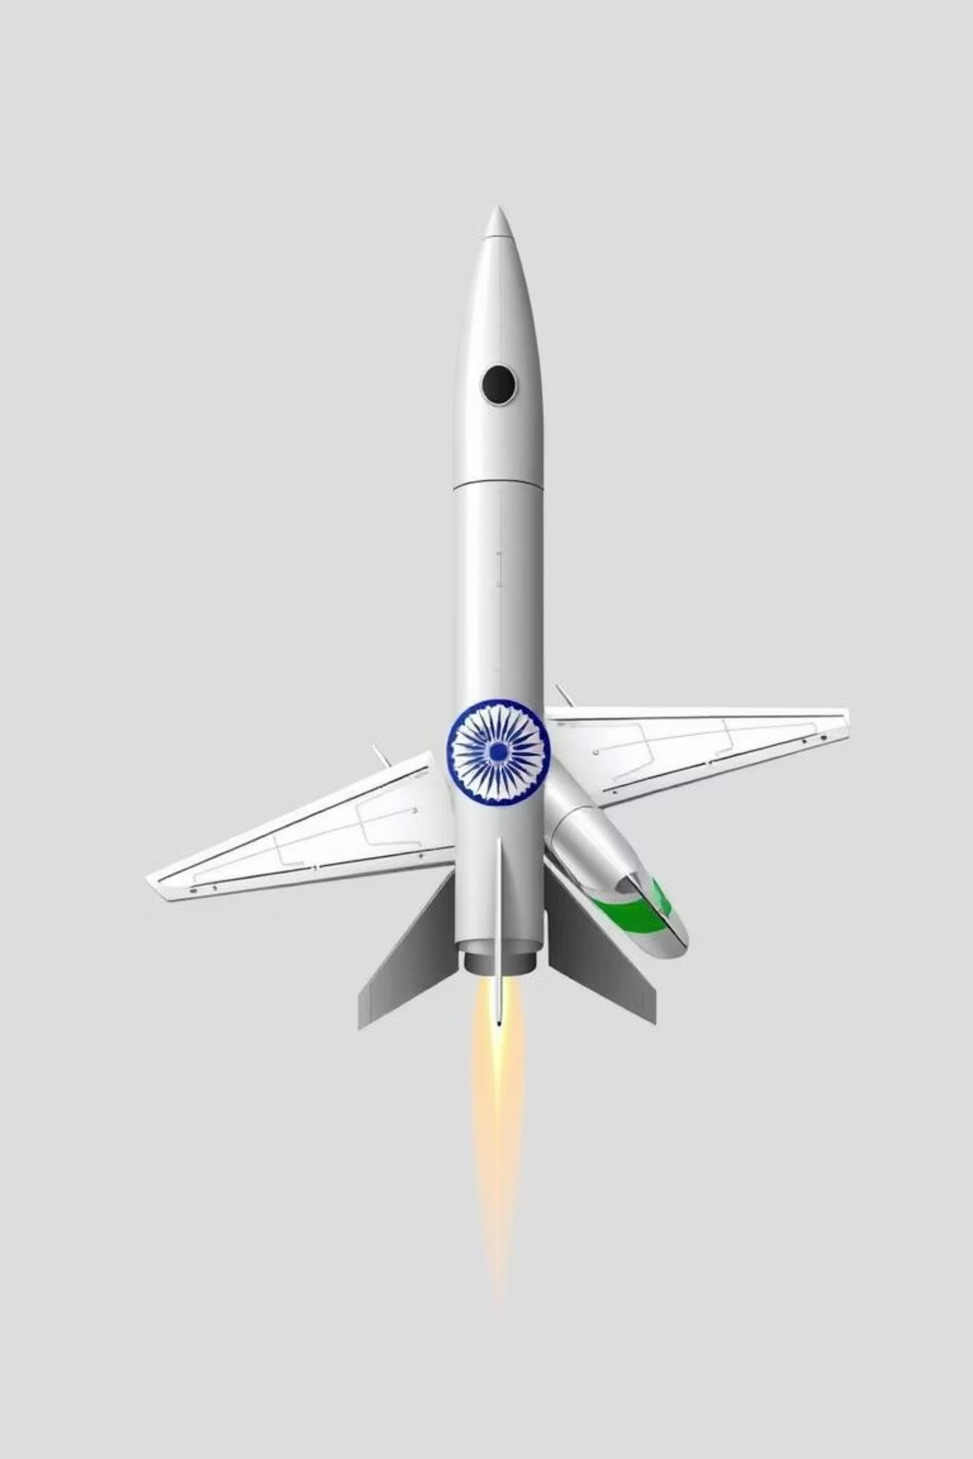


Our Competitive Edge
Tiranga Aerospace stands out through its commitment to indigenous innovation, robust R&D, and strategic partnerships, driving self-reliance in defence and aerospace.
1
Indigenous Innovation
Pioneering 'Make in India' solutions, we deliver customized, cutting-edge technology tailored for national defence requirements.
2
Advanced R&D & Compliance
Our D&D team ensures innovation from concept to testing, adhering strictly to MIL-STD and IPC compliance for superior quality.
3
Skilled Workforce Development
We bridge industry skill gaps by supplying highly trained ITI, Diploma, and
BE graduates, fostering a future-ready workforce.
4
Strategic Collaboration
Strong partnerships with Defence, Aerospace, and DRDO drive mutual growth, accelerating indigenous technology development.

Slide 8






Our Competitive Edge
Tiranga Aerospace stands out through its unique advantages, ensuring superior service and cutting-edge solutions for our clients.
End-to-End Capability
Complete Documentation
From design to final production, all under one roof with valuable OEM support.
Serial traceability and comprehensive delivery records for full transparency.
Agile Execution
Defence-Grade Culture
Quick turnaround with flexibility for custom changes and rapid deployment.
Precision, discipline, and accountability embedded in every process.
Post-Delivery Support
Dedicated onsite and post-delivery support for modifications, servicing, and technical assistance.

Slide 9
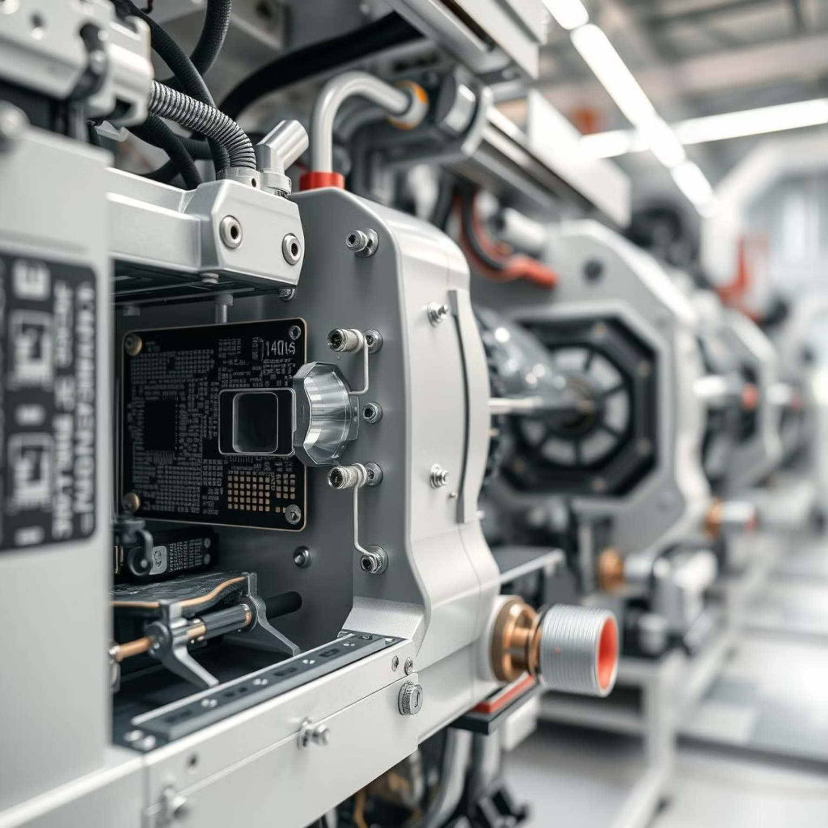
Products & Operational Excellence
Tiranga Aerospace offers a diverse range of products and solutions, underpinned by robust operational frameworks and certified quality management systems.
Product & Solution Domains
Specialized offerings for critical aerospace and defence applications:
Radar Systems: Custom cable harnesses, RF test jigs.
SATCOM Modules: MIL-grade RF cable assemblies, precision enclosures.
Antenna Support Systems: Mechanical fabrication, waveguide assemblies.
RF Products: LNAs, filters, power splitters, Ka-band units.
Raw Material Supply: Delivered via Tiranga E-Mart, our dedicated sourcing platform.
Operational Highlights
Our operations adhere to the highest standards, ensuring efficiency and reliability:
On Time Delivery with scalable production capacity.
IDMS Tool: Centralized system for workflow, HR, and inventory control.
Integrated Workflow: CAD → Simulation → Fabrication → Testing.
ISO 9001:2015 certified quality management systems.

Slide 10

Let’s Connect and Collaborate
We appreciate your time and attention. Tiranga Aerospace is committed to building reliable, high-performance solutions for the Defence and Aerospace sectors.
Precision. Partnership. Performance.
Thank you for considering Tiranga Aerospace as your trusted partner.

